Slide 1

Homework 1
greatest common divisor
Please enter two positive integers, use the while loop to design a program, and find the greatest common divisor

Slide 2
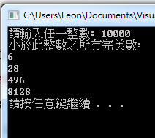
Homework 2
perfect number
If a number is exactly equal to the sum of its divisors (not including itself), then this number is called a perfect number。
For example : 6 = 1 + 2 + 3。 Try to design a program, the user enters any integer, and the output is all perfect numbers less than this integer (including this integer).

Slide 3
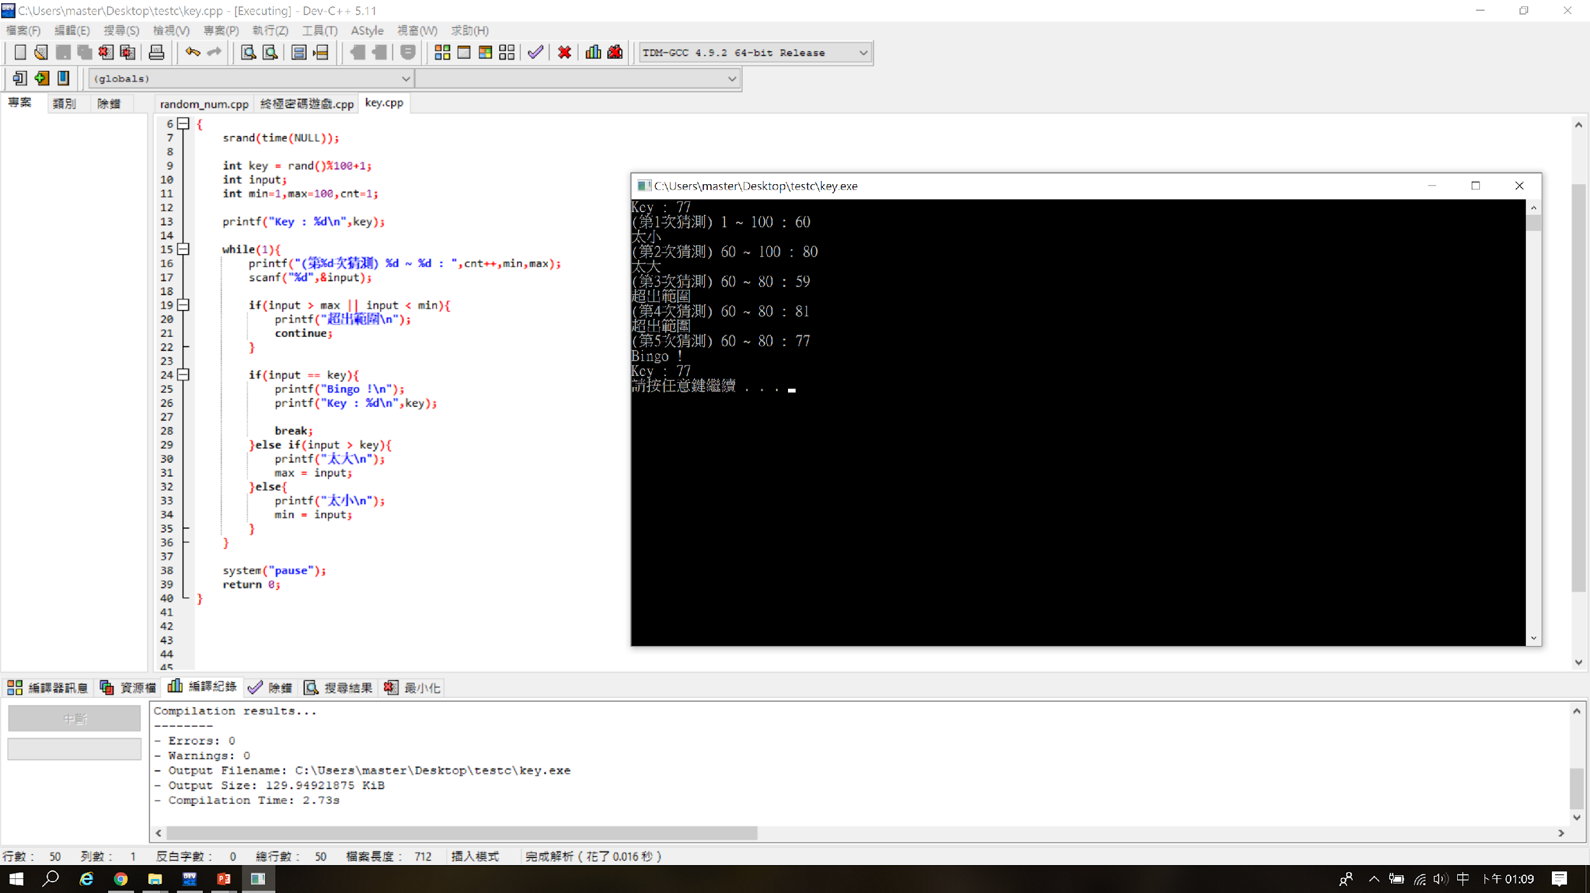
Homework 3
Guess the number game
Use the random number generator to generate an integer between [1,100], allowing the user to guess the generated random number, and prompt whether it is "too large" or "too small" according to the user's guessed value, and the range will be changed accordingly.
If the guessed value is out of range, it will prompt ”超出範圍”
prompt : while(1) , continue , break
-> Too small
-> Too large
-> out of range
-> out of range

